Slide 1
Pain
By: Nicole Phillips

Slide 2
Learning Objectives
Differentiate somatosensory receptors and their functional importance
Describe the anatomical pathways that convey sensory input from the body and face to the brain
Predict the location of damage from presentation of clinical symptoms

Slide 3
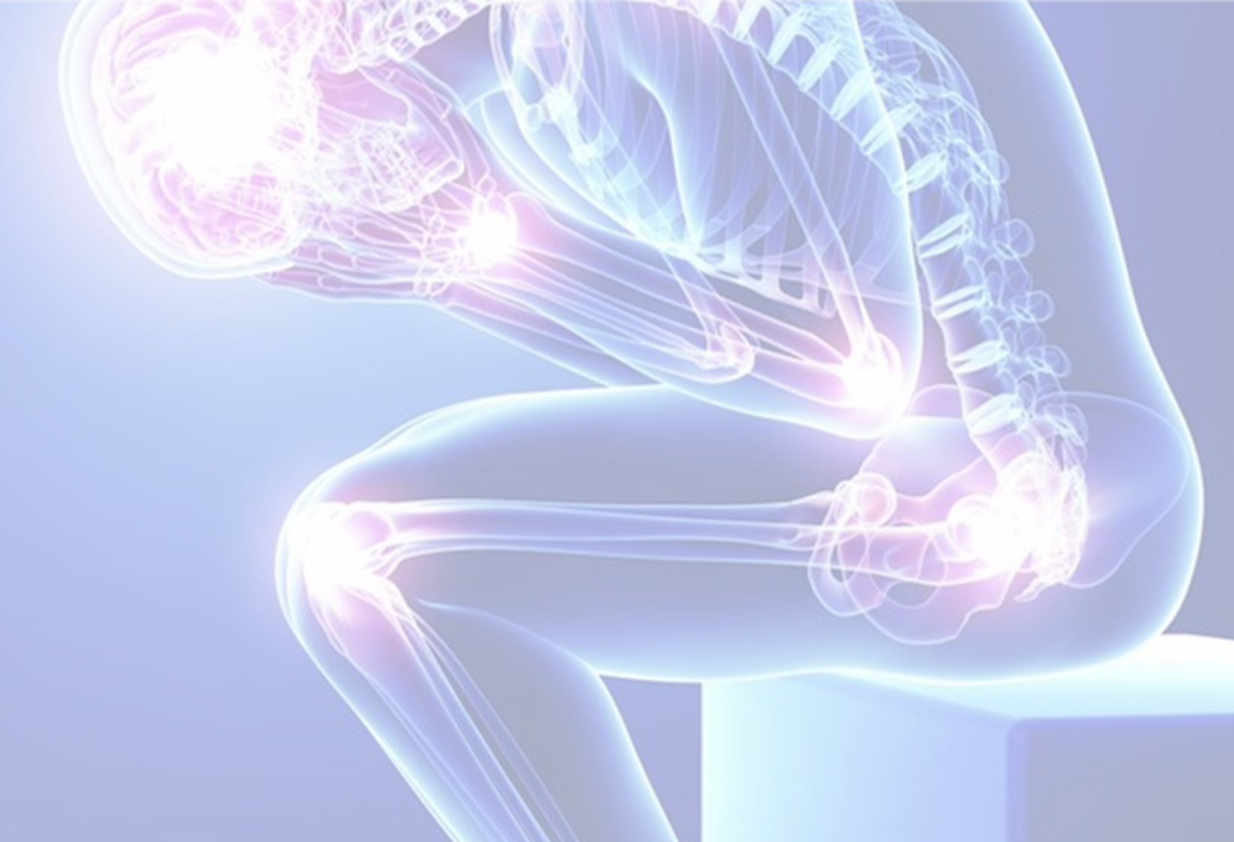
Pain
Textbook: unpleasant sensory and emotional experience associated with stimuli that cause tissue damage.
International Association for the Study of Pain (IASP): An unpleasant sensory and emotional experience associated with, or resembling that associated with, actual or potential tissue damage, or described in terms of such damage.
https://www.iasp-pain.org/Education/Content.aspx?ItemNumber=1698

Slide 4
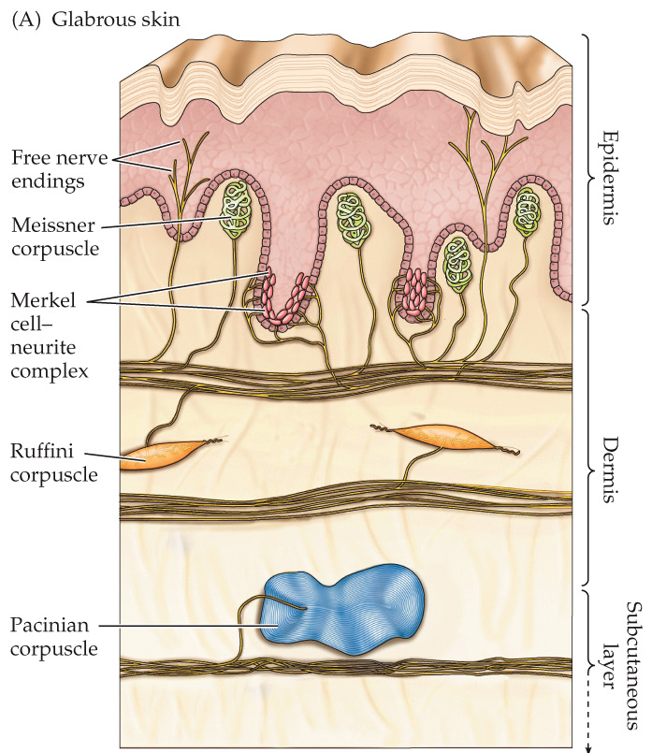
Nociception
Nociception: the processing of noxious sensations by the nervous system
  Noxious stimulus: a stimulus that is damaging or threatens to damage normal tissue.
Nociceptors: receptors specialized for the detection of noxious stimuli.
  free nerve endings
  located in the skin, muscles, and internal organs
  activated by mechanical stimulation, chemicals, and temperature change

Slide 5
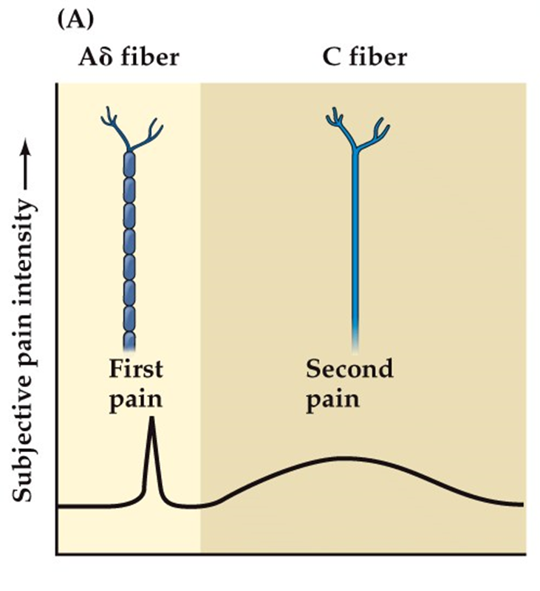
Types of Nociceptors
Aδ nociceptor
  Larger diameter, myelinated axons
  First/fast pain
  Sharp stinging pain that draws attention to where the pain signal is coming from
C nociceptor
  Smaller diameter, unmyelinated axons
  Second/slow pain
  Dull longer lasting pain that encourages recovery.

Slide 6
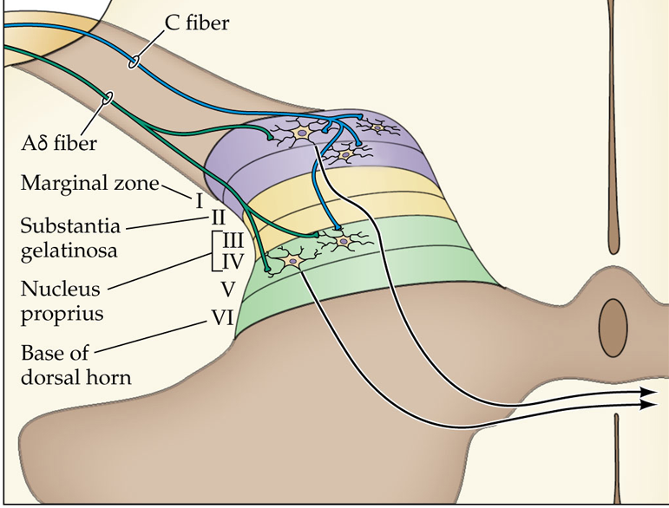
pain pathways: the Anterolateral system
Nociceptive afferents enter the spinal cord through dorsal roots.
C fibers primarily terminate in layers I & II of the dorsal horn
Aδ fibers primarily terminate in layers I and V

Slide 7
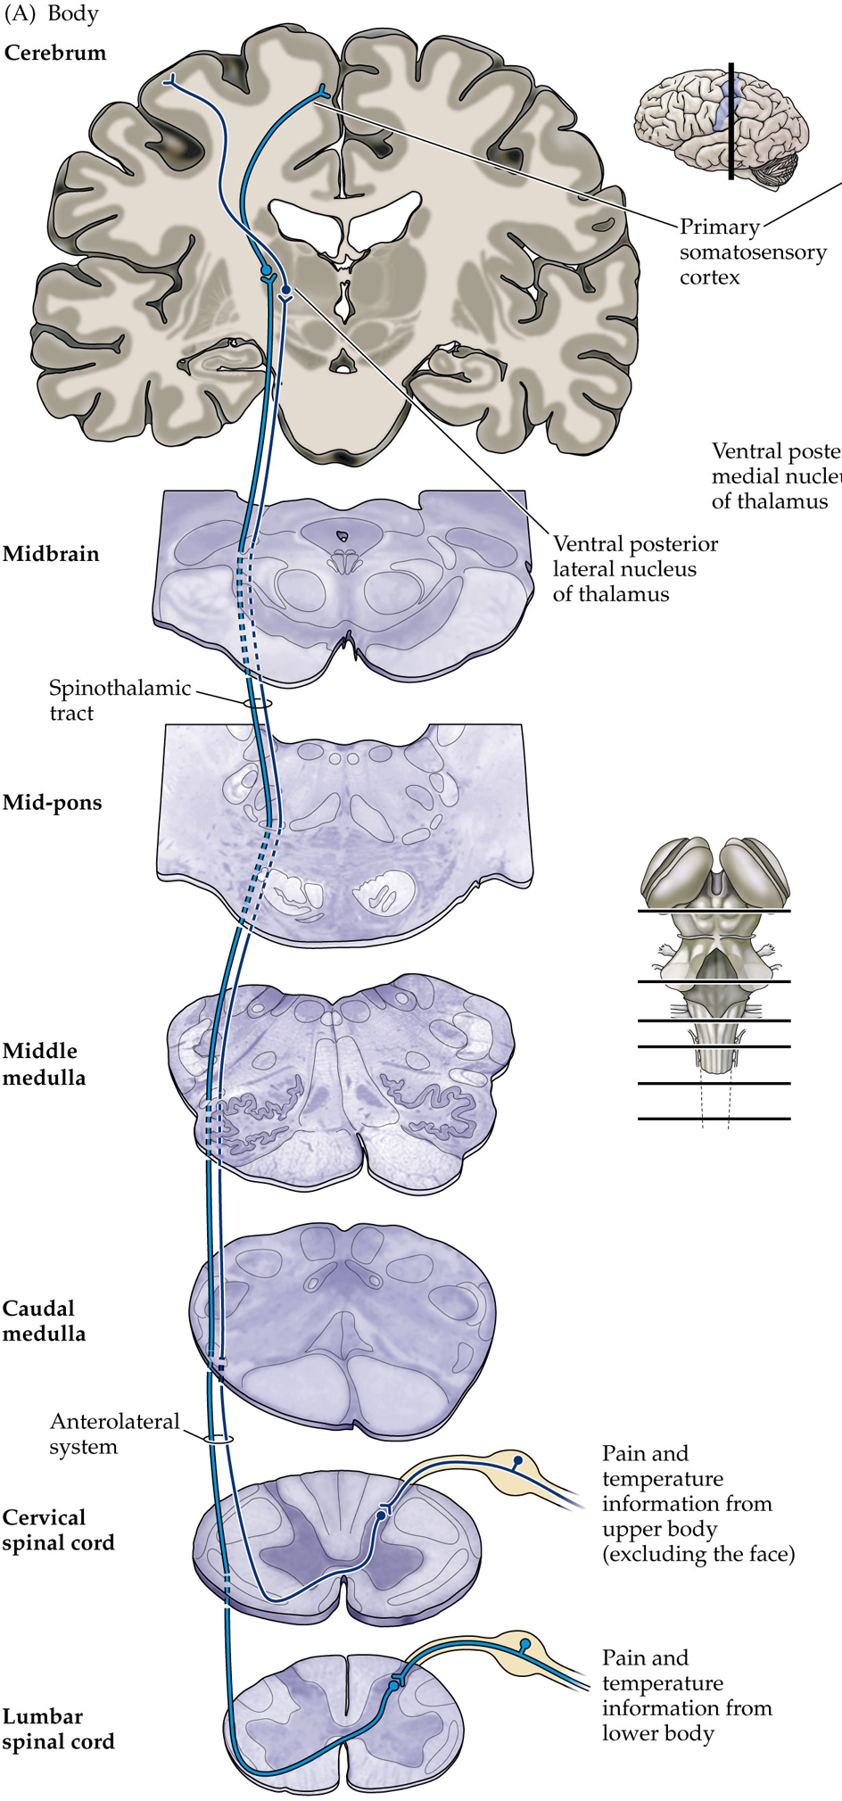
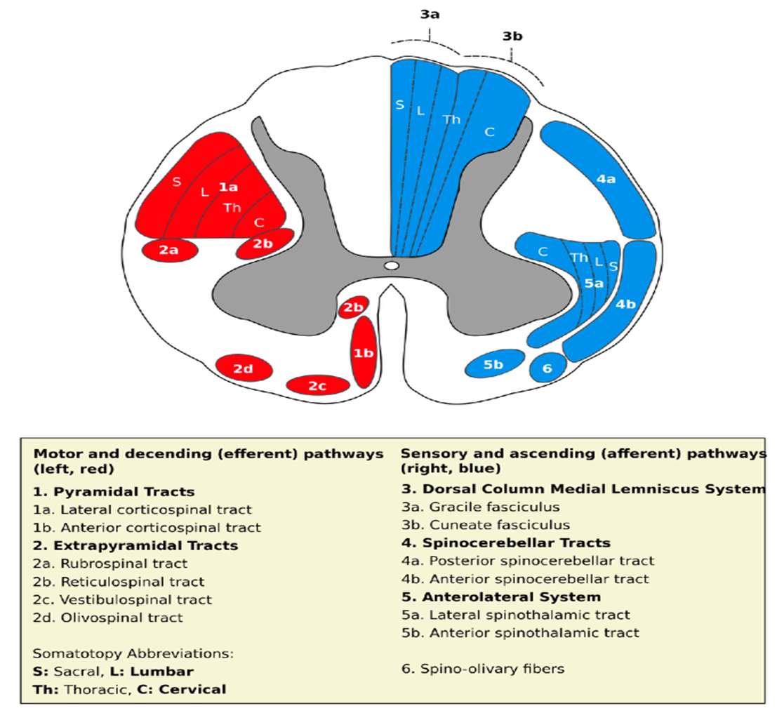

pain pathways: the Anterolateral system
Follows a similar path as DC/ML, but through different parts of white matter in the spinal cord.
Nociceptive afferents synapse with 2nd order neurons in the dorsal horn.
Axons cross the midline in the spinal cord and then ascend through the spinothalamic tract.
  Fast pain fibers synapse with neurons in the VPL (3rd order projecting to somatosensory cortex).
  Slow pain fibers have more widespread targets in the brain.

Slide 8
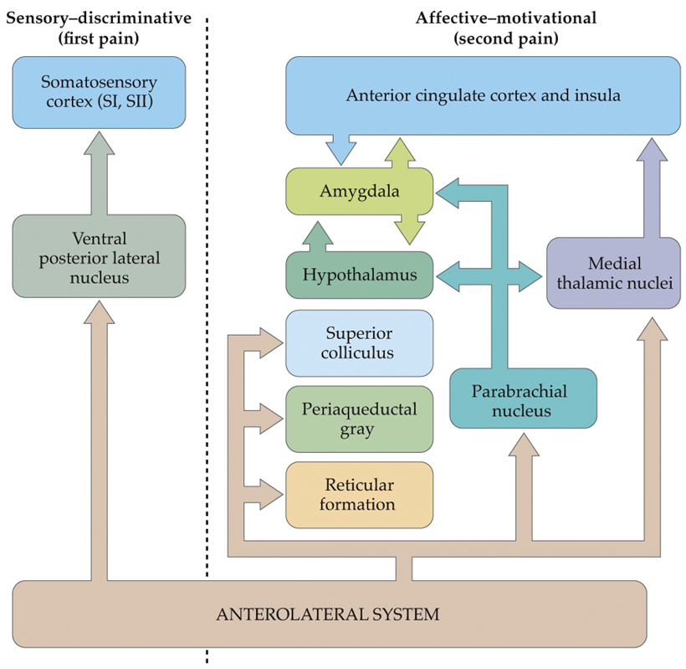
pain pathways: the Pain matrix
Sensory discriminative: the location, intensity, and quality of the pain.
  Often described as shooting, stinging, throbbing, etc…
Affective-motivational: emotional aspects of pain.
  Often described as tiring, sickening, fearful, etc…

Slide 9
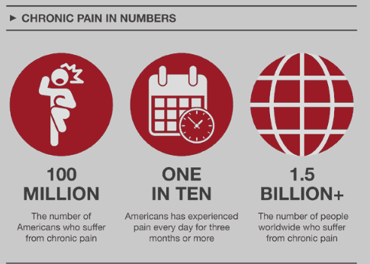
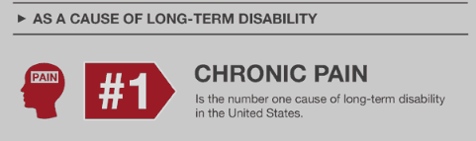
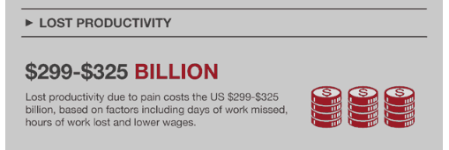
Clinical applications:
Chronic pain
Long standing pain that persists beyond the usual recovery period or occurs along with a chronic health condition (e.g. arthritis)
  Typically pain must last at least 3 months
  Causes significant dysfunction
  Can be continuous or relapsing
Three broad types:
  Neuropathic pain
  Inflammatory pain
  Deafferentation pain

Slide 10
Brain Structural and Functional Changes associated with chronic pain
Chronic pain is associated with reduced gray matter in prefrontal cortex and the Thalamus (Apkarian et al, 2004)
As pain shifts from acute to chronic, brain activity shifts from sensory regions to more limbic regions (Yang & Chang, 2019).
  Amygdala may be hypersensitive
  Hippocampus may form persistent pain memories
  Nucleus Accumbens (technically BG) functional connectivity with medial prefrontal cortex is a significant predictor of chronic pain.

